Slide 1
CFS Test Framework (CTF)
Design As Built
NASA – JSC (ER6)

Slide 2
Introduction
The CFS Test Framework (CTF) enables automated requirement testing and verification for flight software projects
At a high level - CTF
Parses test script files containing test instructions (JSON)
Interfaces with the relevant external systems (CFS, Trick, etc…)
Executes test script(s) instructions
Reports and logs test results
CTF utilizes a (python) plugin system to allow project-specific extensions of the framework
Plugins allow developers to extend CTF with new test instructions and external interfaces.
CTF provides the following default plugins -
CFS Plugin | Interfaces with one or more CFS instances
CCSDS Plugin | Defines and imports CCSDS message definitions
SSH Plugin | Provides SSH functionality. Used by CFS plugin for remote targets.
User IO Plugin | Provides use input/output functionality
Example Plugin | Provides a minimal sample plugin

Slide 3
CTF History
Original test and verification environment was created for C2V2
Reworked and re-used by OpNav, AA2, xEMU, and BFS
Architecture, code-base, and input test files were incompatible between the versions
Made it difficult to merge changes across different projects and test environments
Several project-specific features and interfaces were embedded
Made test environment less generic and more difficult to deploy for other projects
Goal with CTF
Create an extensible, modular, yet simple, architecture
Reduce overhead of set up and use by new projects
Enable Ease of extending CTF with project-specific features and interfaces
Allow plugin re-use across projects for similar interfaces or functionality

Slide 4
Architecture Overview
External Files
CTF Core (Python)
CTF Plugins (Python)
External Systems
Test Script 1
CFS Plugin
CFS Instance(s)
Test Script 1
Script Reader
Script Manager
Test Scripts (JSON)
Config File (INI)
Config Manager
Time Manager
SSH Plugin
Remote Target
CCSDS Info (JSON)
CCSDS Manager
Plugin Manager
Custom Project Plugin(s)
Log Files (JSON/CSV)
Logger
Status Manager
CTF Editor/Runner
GUI

Slide 5
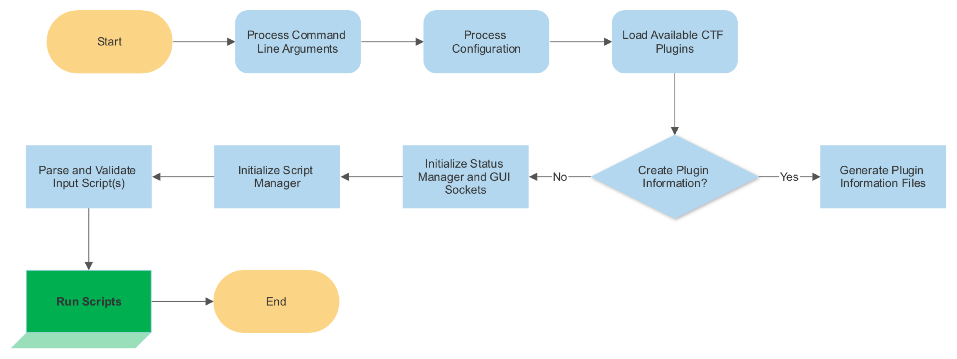
Flow Control – CTF Core

Slide 6
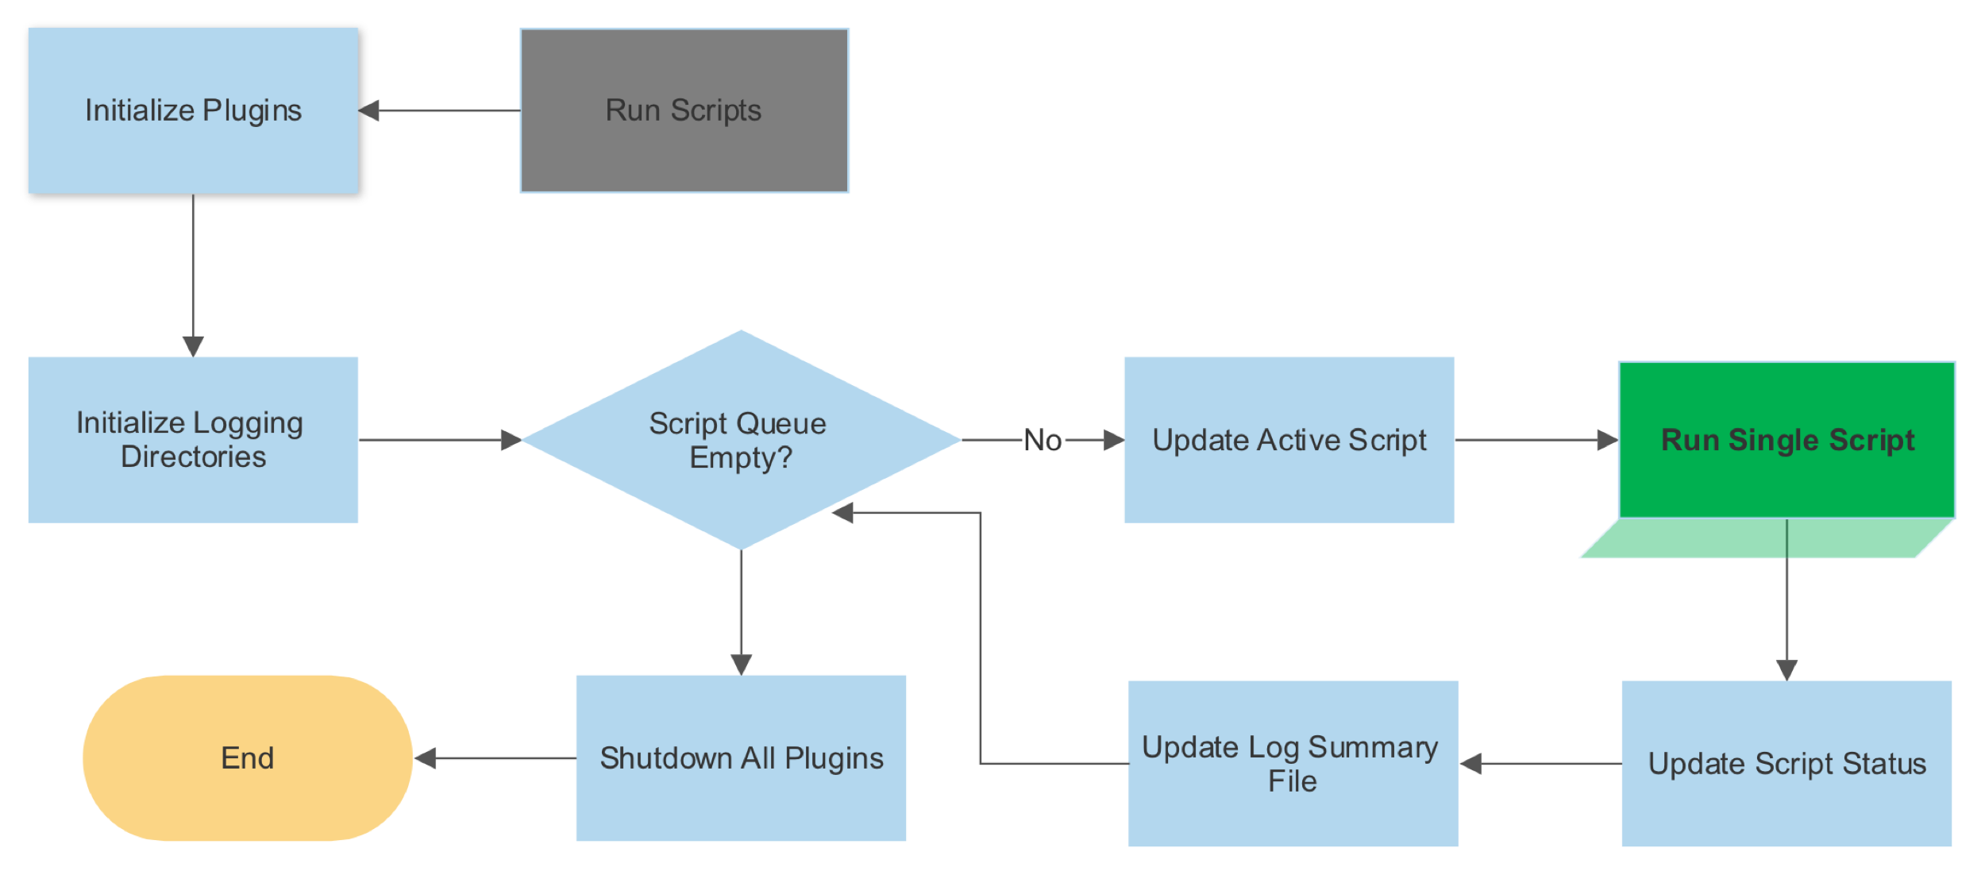
Flow Control – Script Manager

Slide 7
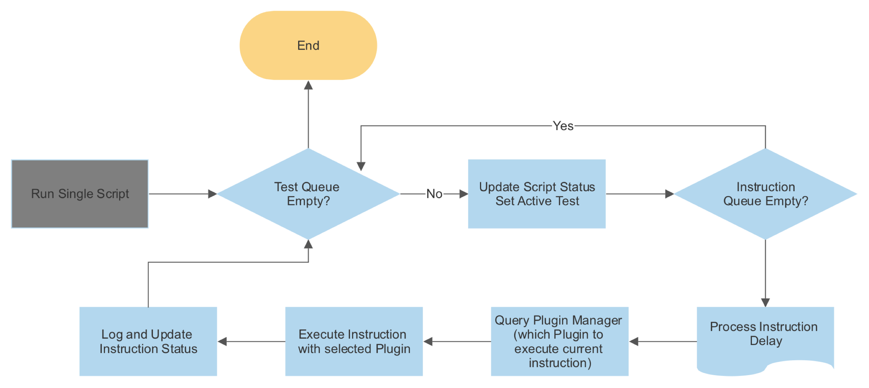
Flow Control – Script Execution

Slide 8
CFS Plugin - Test Instructions
Instruction | Description
RegisterCfs | Register a CFS Instance and load its configuration
BuildCfs | Build a CFS Instance
StartCfs | Start a CFS Instance
EnableCfsOutput | Enable CFS Output - Send the TO Enable Output Command
SendCfsCommand | Send a CFS Command
SendInvalidLengthCfsCommand | Send a CFS Command with an invalid payload length
CheckEvent | Check that a CFS Event Message was received
CheckTlmValue | Check that a CFS Telemetry Value was received
CheckTlmContinuous | Add a continuous check for a CFS Telemetry Value
RemoveCheckTlmContinuous | Remove a continuous check for a CFS Telemetry Value
ArchiveCfsFiles | Archive artifact files produced during the test run in the results
ShutdownCfs | Shutdown a CFS Instance

Slide 9
CCSDS Plugin
Instruction | Description
ValidateCfsCcsdsData | Sends all CFS Commands defined in the CCSDS Data. Commands are sent with a zeroed-out payload. This instruction can be used to verify valid command lengths.
Note
The CCSDS Plugin also provides a CCSDS Header interface for implementing custom CCSDS header definitions. Refer to the CCSDS Plugin README for more information.

Slide 10
SSH Plugin
Instruction | Description
SSH_RegisterTarget | Declares an SSH target by name.
SSH_InitSSH | Establishes an SSH connection with a target host.
SSH_RunRemoteCommand | Executes a command on the remote host.
SSH_RunLocalCommand | Executes a command on the local host.
SSH_CheckOutput | Compares the output of the most recently executed command.
SSH_PutFile | Copies a path (file or directory) from the local filesystem to the remote host via rsync.
SSH_GetFile | Copies a path (file or directory) from the remote host to the local filesystem via rsync.
SSH_GetFTP | Downloads a path (file or directory) from the FTP server to the local filesystem.
SSH_PutFTP | Uploads a path (file or directory) from the local filesystem to the FTP server.
Note
The SSH Plugin is used by the CFS Plugin when running with remote CFS targets over SSH.

Slide 11
User IO Plugin
Instruction | Description
WaitForUserInput | Wait for user confirmation before proceeding to the next test instruction
Note
The User IO Plugin may later be extended with additional input/output functionality to interact with a user.

Slide 12
Example Plugin
Instruction | Description
TestCommand | Simply logs that the test command was executed with the provided arguments.
TestVerifyCommand | Increments the plugin's example_counter value and checks if it is greater than 5
TestSharedLibraryCommand | Demonstrates loaded a C shared library by a CTF plugin
Note
The example plugin serves as a developer reference to creating new CTF plugins. The example plugin is meant to be a minimal plugin demonstrating a test command, and a test verification.

Slide 13
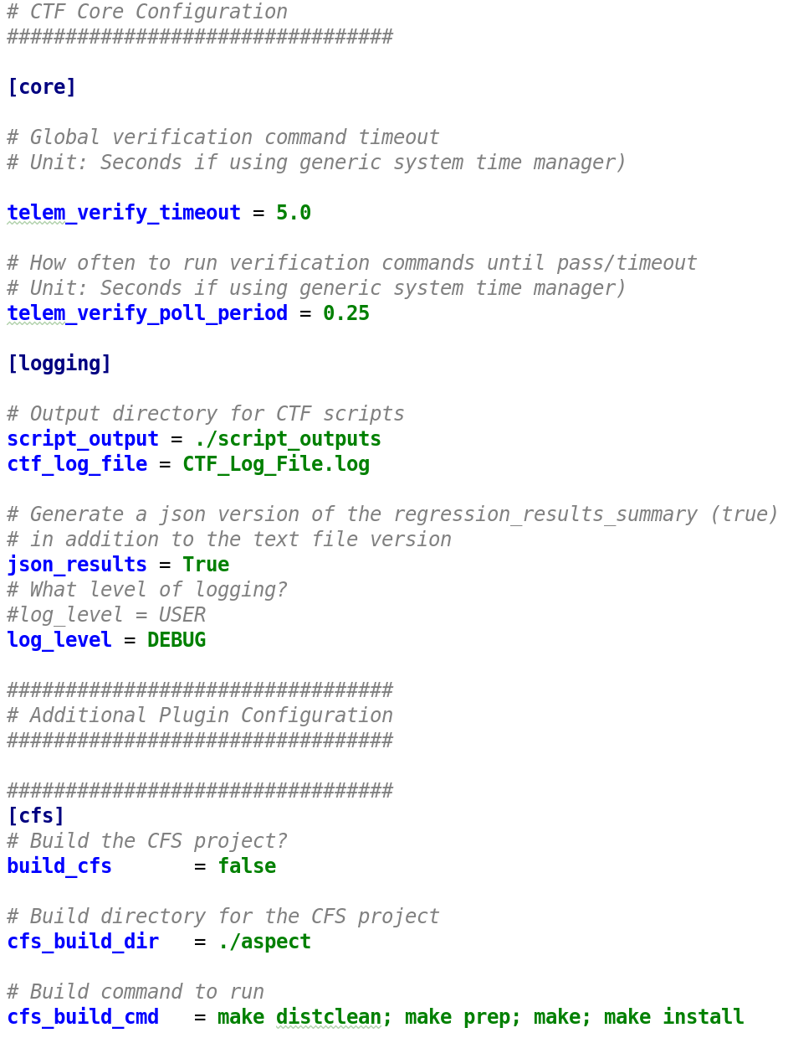
Configuration File
CTF and Plugin Configurations are set in INI config file.
CTF loads default_config.ini unless a config file is specified via command line argument.
Allows running with different configurations (for example user vs. CI configurations)
INI contains different configuration sections for each component or plugin
CTF Core
Logging
CFS
…
Can be easily extended with more parameters as CTF evolves

Slide 14
CTF Editor
CTF Provides a GUI tool with script editing and running capabilities.
Enables test developers to easily create, modify, update, and test CTF JSON scripts.
Aims to be completely data-driven
CTF backend generates plugin information files used by editor to render the UI
New commands and functionality are automatically supported by the editor without changing code
Editor integrates with CCDD data exports for CCSDS message definitions
Maintains the ability to edit JSON test scripts using other editors (if needed)
Uses several modern UI/UX libraries allowing
Drag and drop of test instructions, functions, etc…
Autocompletion of MIDs, Telemetry Fields, Command Arguments, etc…
…
Allows running of JSON Test Scripts by invoking CTF with the necessary command line arguments
Establishes a socket connection to communicate test suite state
Uses several modern WebApp technologies
Electron
React
Typescript

Slide 15
CTF Editor

Slide 16
Acknowledgements
Doyle Mills
Deep Mukherji
Jacob Macneal
Guy de Carufel
Christopher (Scott) Cox
Eric Vineyard
William Whitehouse
John Lutteringer
Matthew Russel
Bryan Willis
Travis Christian
Tao Wu
Lore Prokop
Tam Ngo

